Slide 1
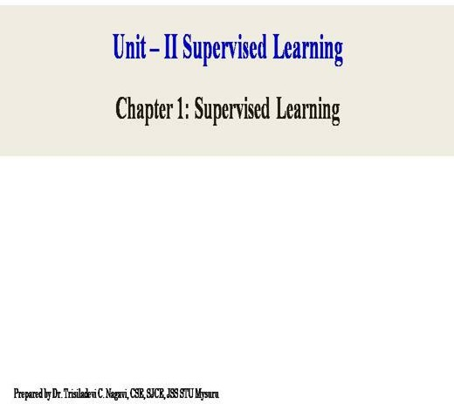

Slide 2
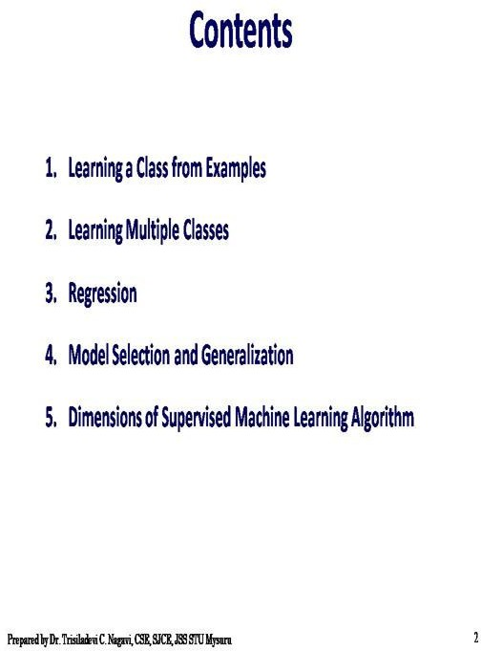

Slide 3
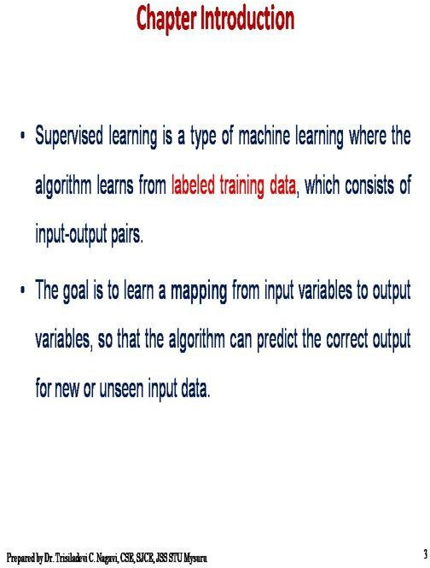

Slide 4
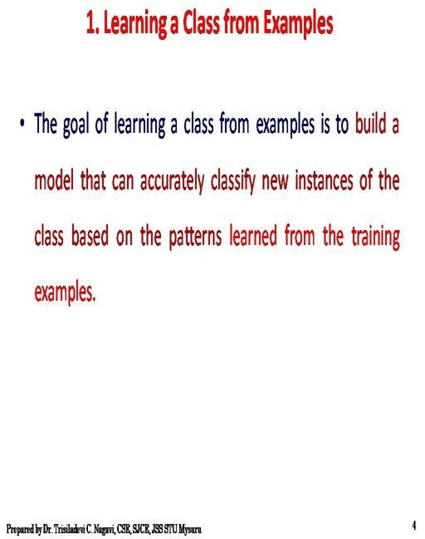

Slide 5
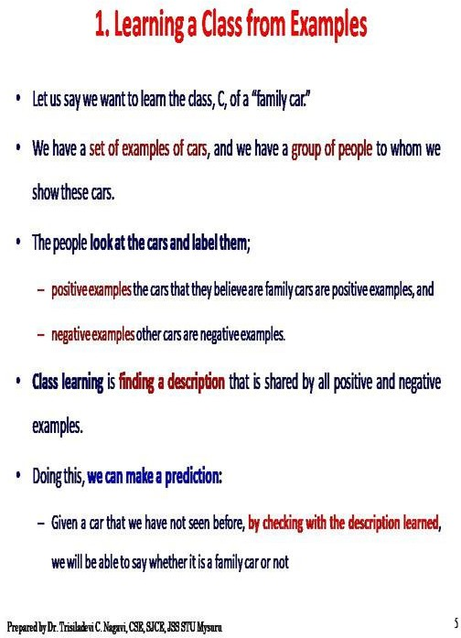

Slide 6


Slide 7
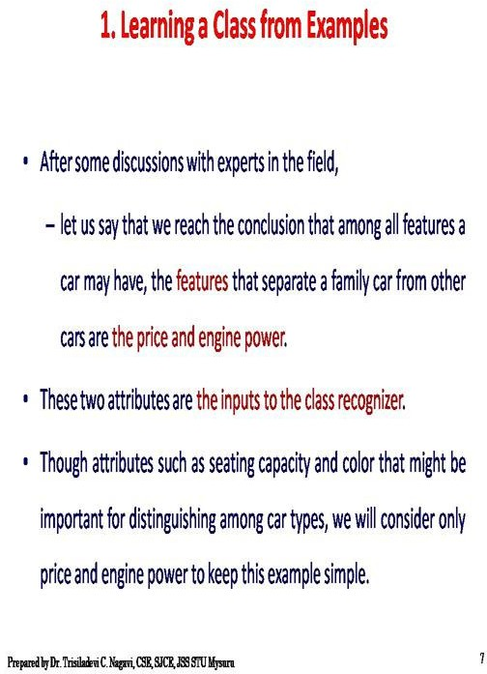

Slide 8
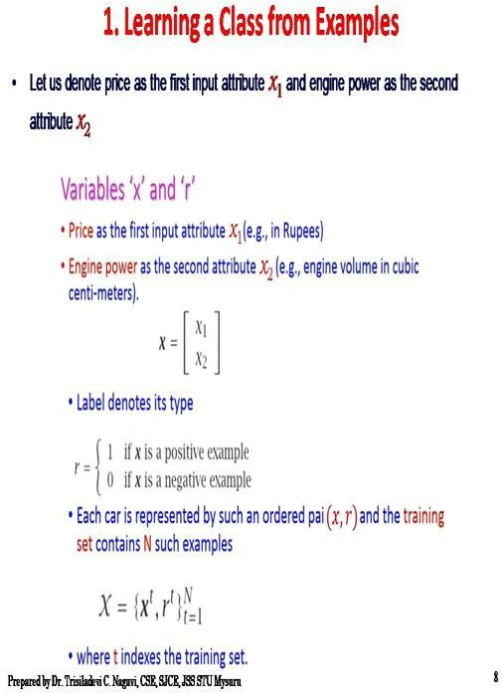

Slide 9
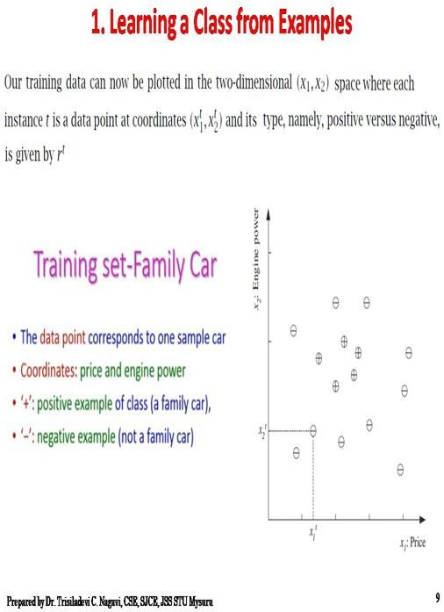

Slide 10
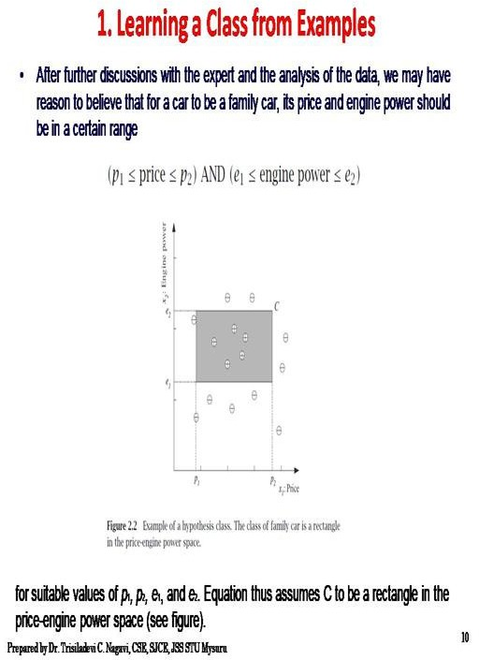

Slide 11
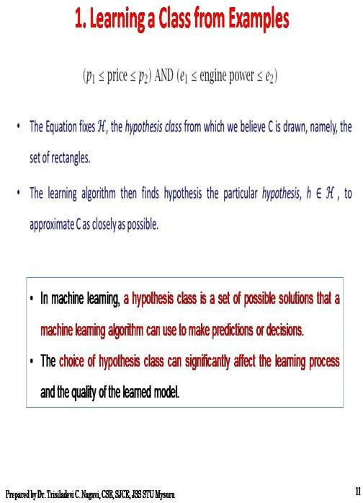

Slide 12
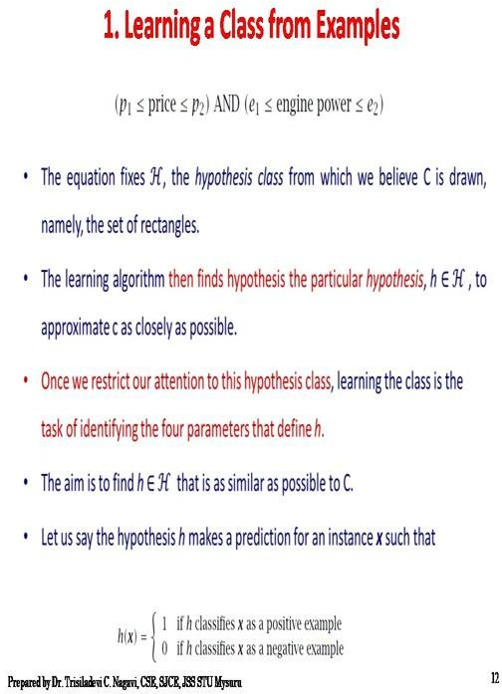

Slide 13
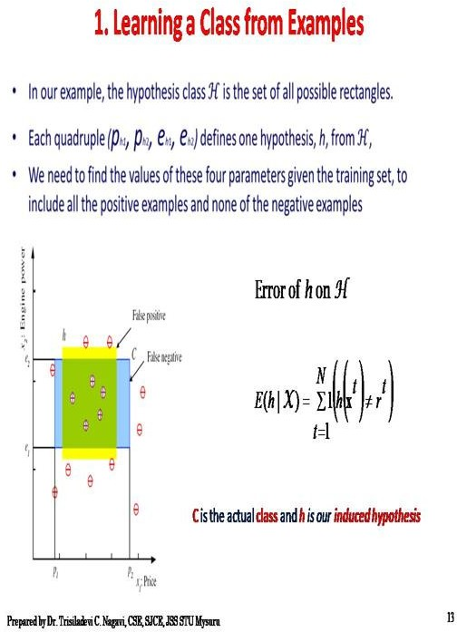

Slide 14
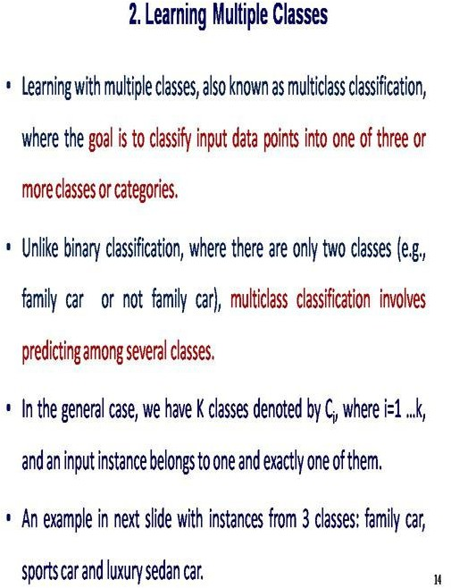

Slide 15
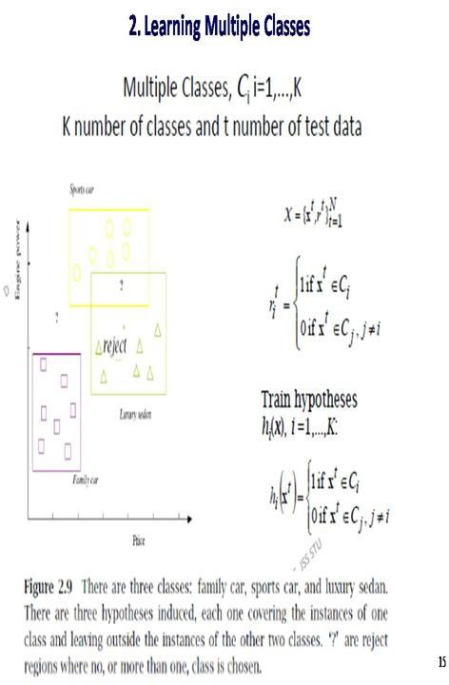

Slide 16
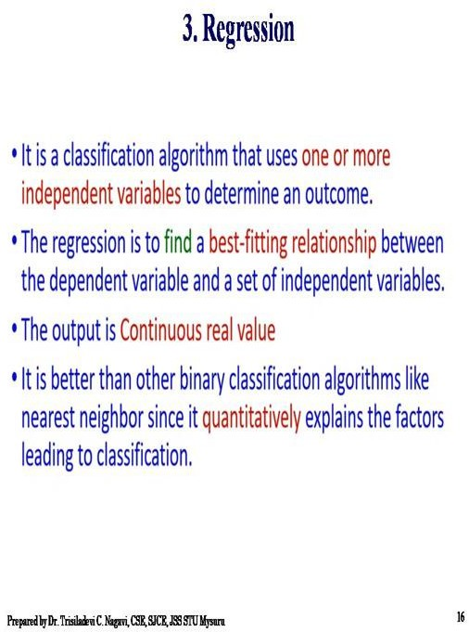

Slide 17
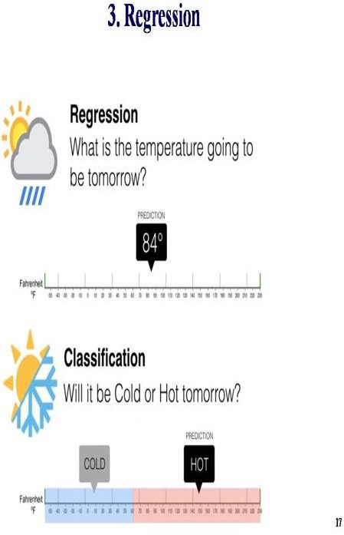

Slide 18
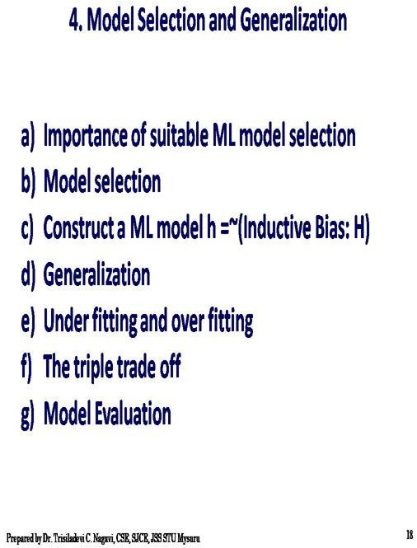

Slide 19
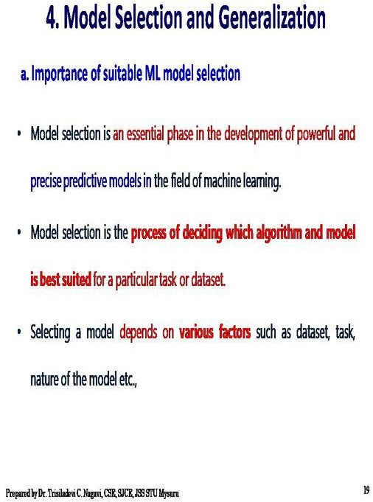

Slide 20
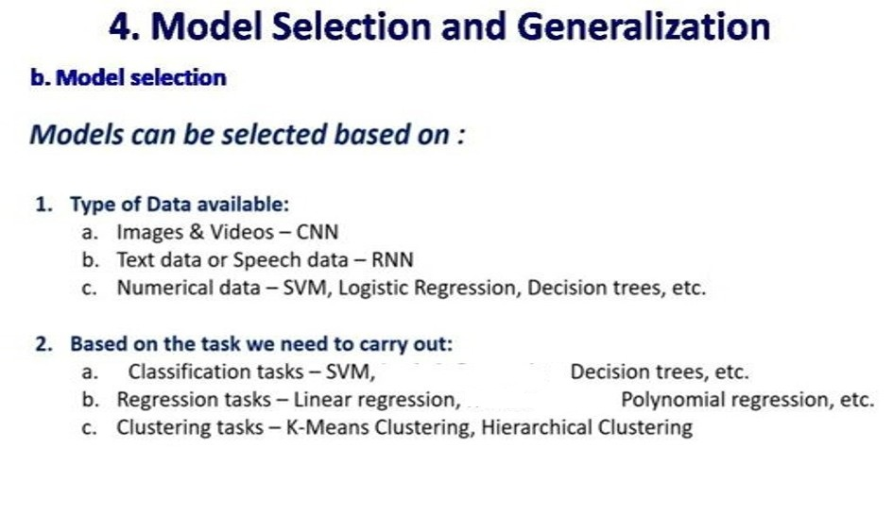

Slide 21
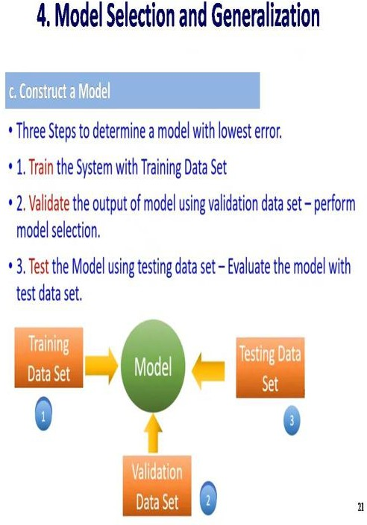

Slide 22
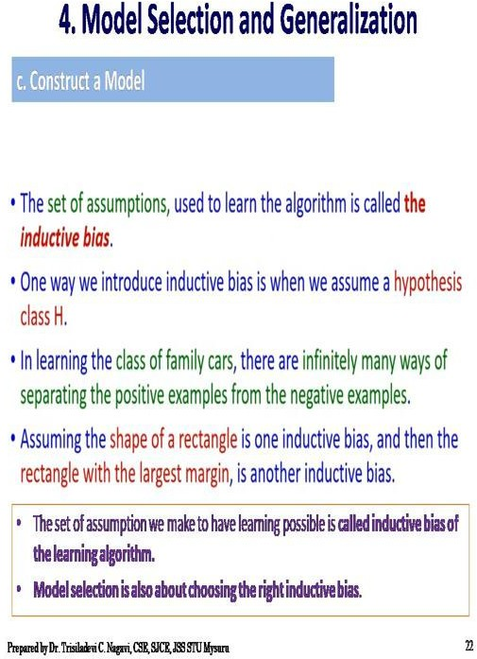

Slide 23
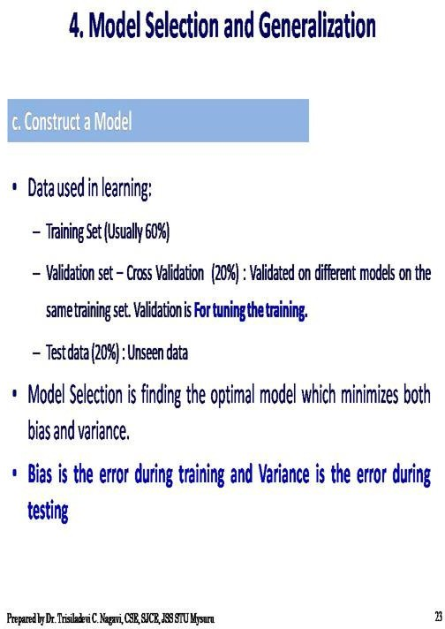

Slide 24
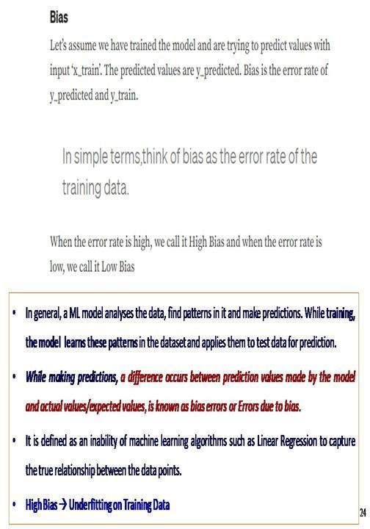

Slide 25
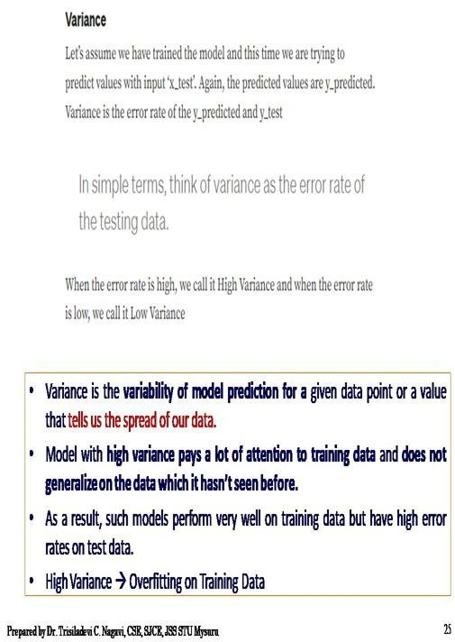

Slide 26
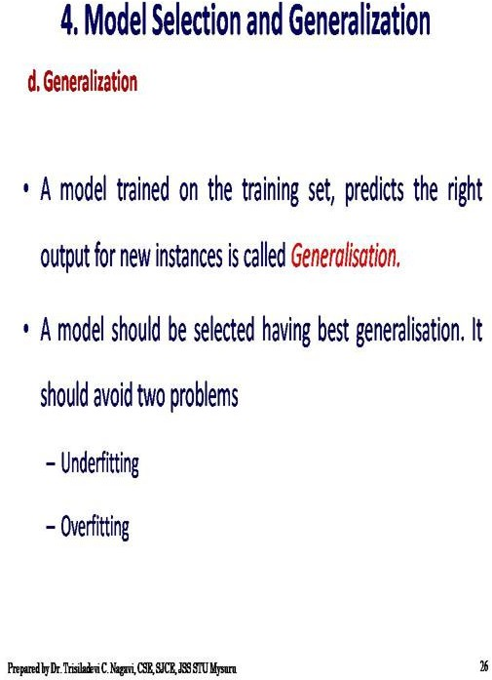

Slide 27
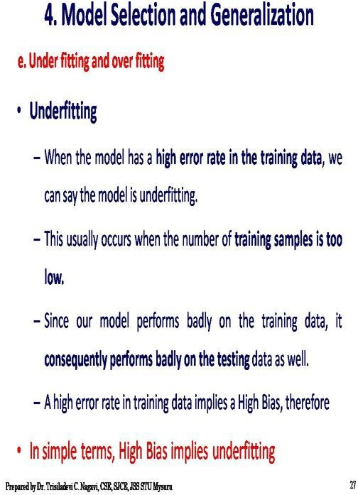

Slide 28
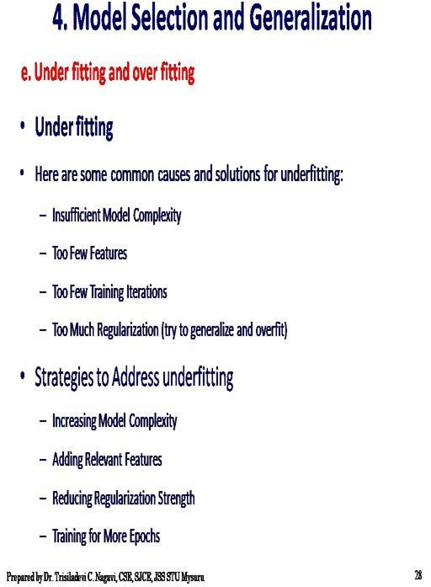

Slide 29
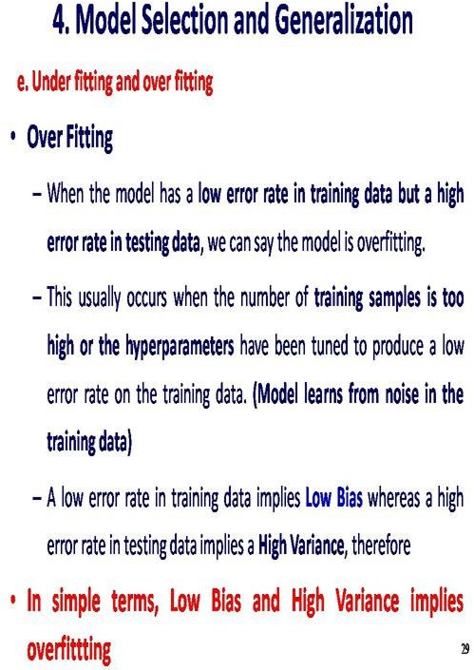

Slide 30
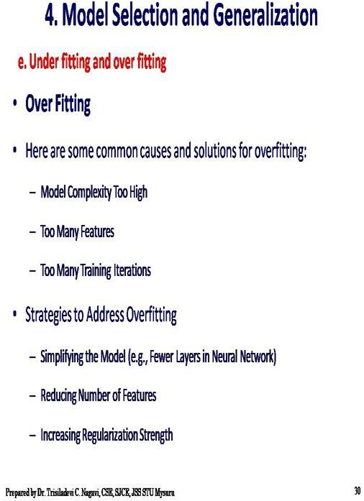

Slide 31
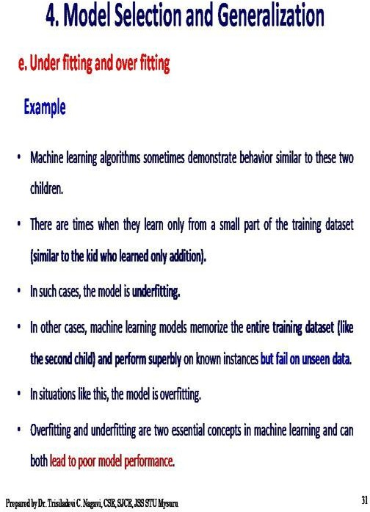

Slide 32
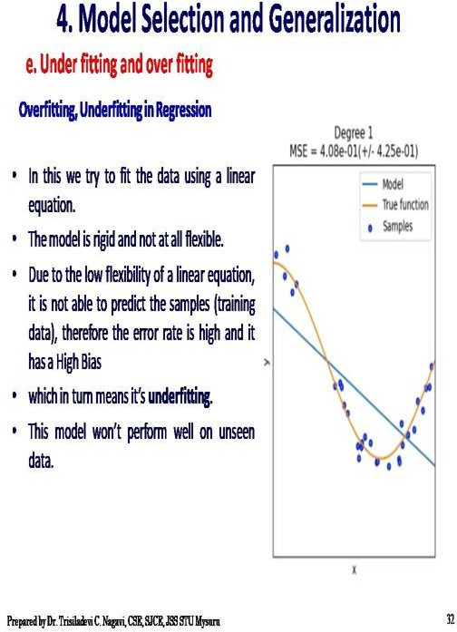

Slide 33
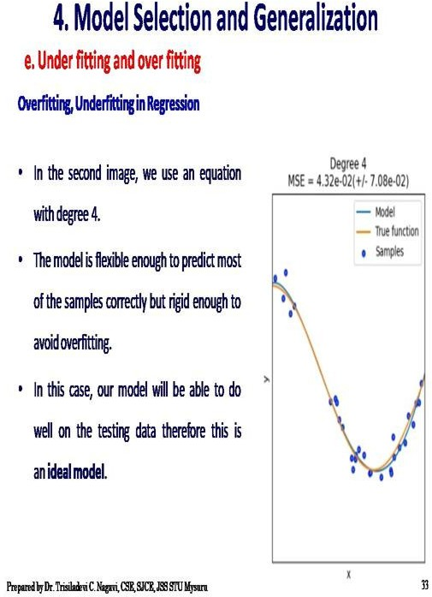

Slide 34
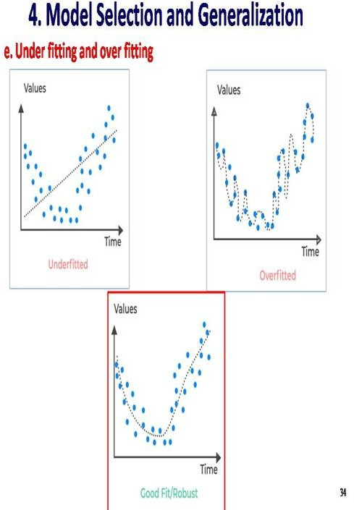

Slide 35
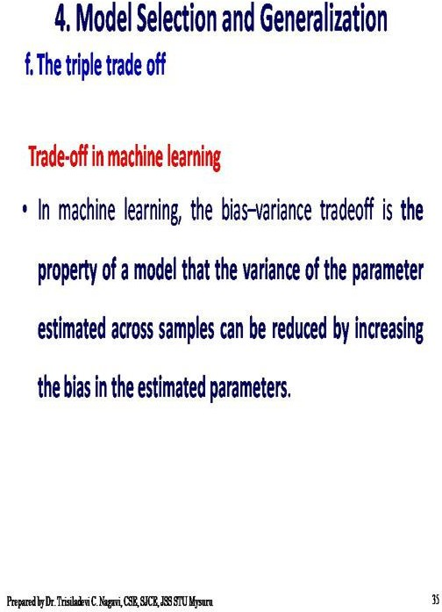

Slide 36
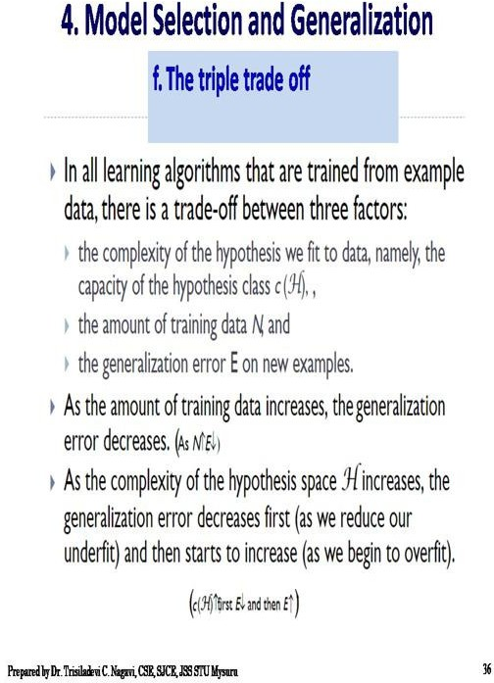

Slide 37
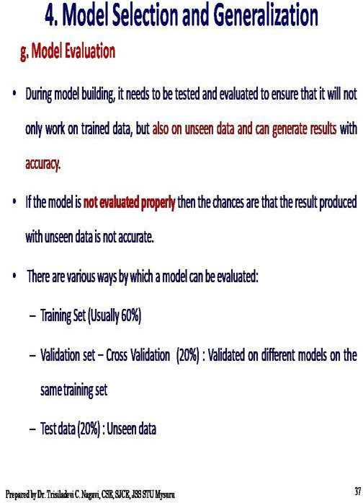

Slide 38
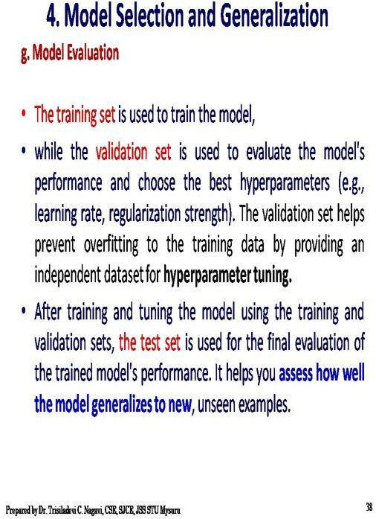

Slide 39
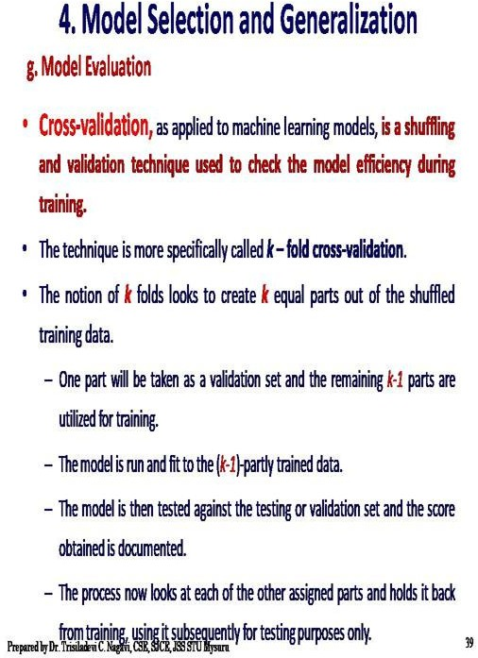

Slide 40
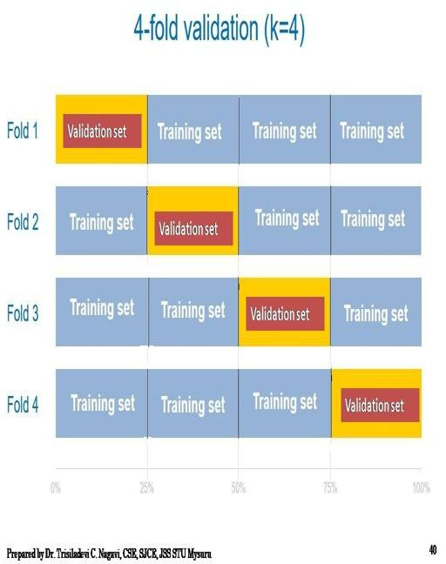

Slide 41
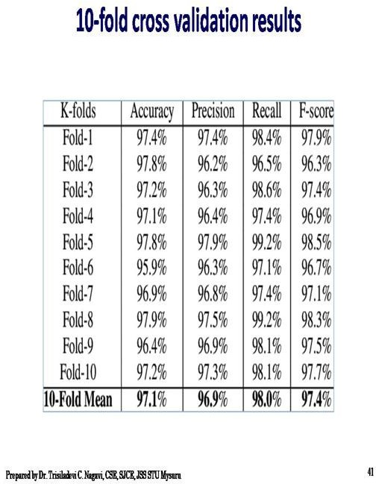

Slide 42
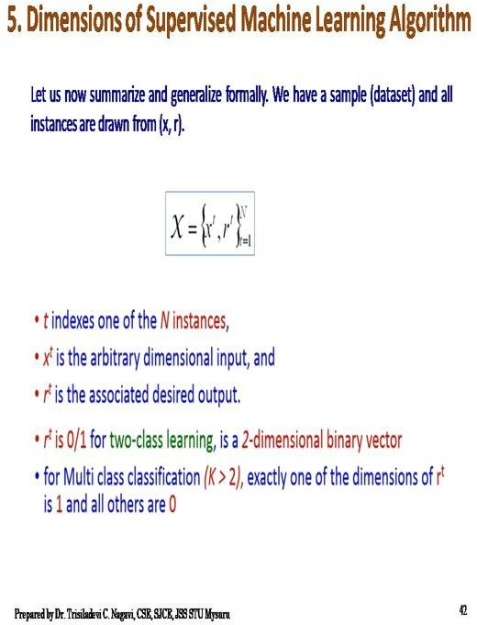

Slide 43
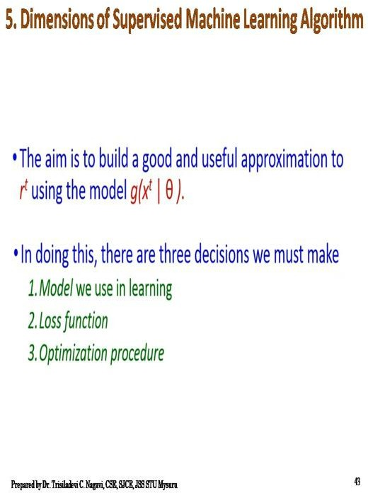

Slide 44
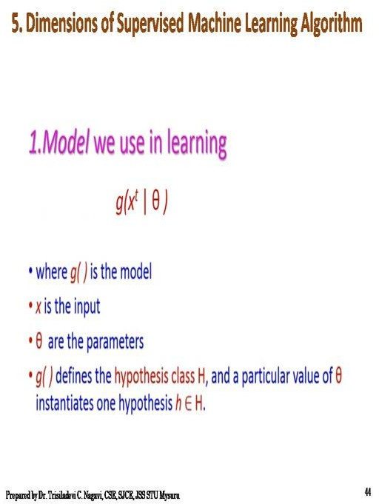

Slide 45
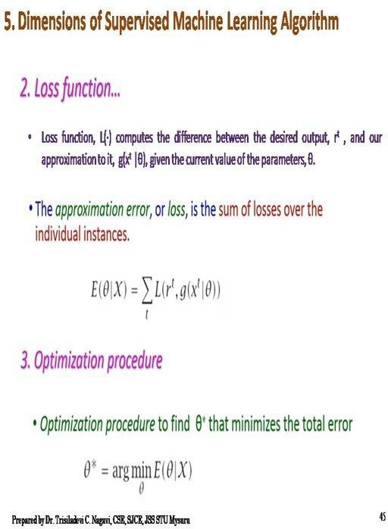

Slide 46
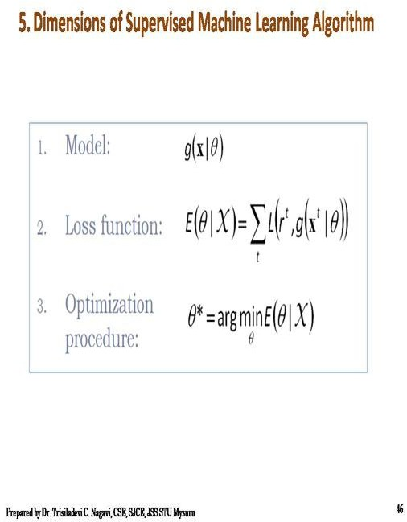

Slide 47
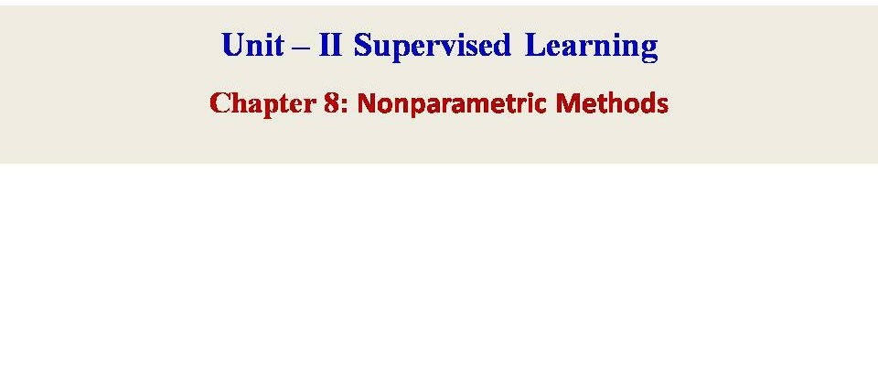

Slide 48
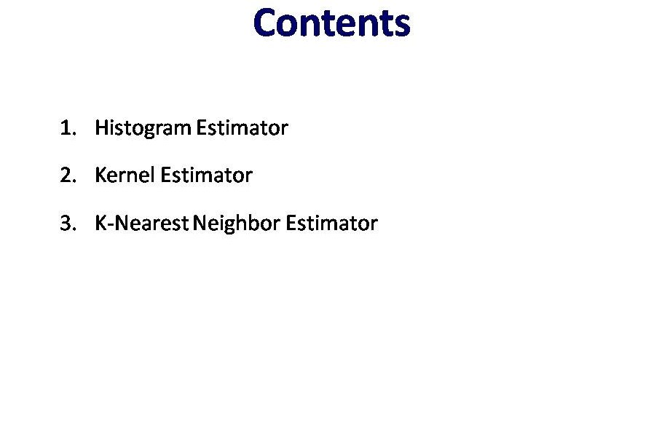

Slide 49
Parametric Estimation
Each parameter often has a clear meaning (like slope, intercept, mean).
Estimating a fixed number of parameters that define a known type (or form) of model or probability distribution.
This means:
We assume the data comes from a specific distribution (e.g., normal, exponential, etc.).
We then estimate the parameters (like mean, variance) of that distribution from the sample data.

Slide 50
Why Do We Need Parametric Estimation?
Simplicity - simpler and easier to compute, you just need to estimate a few parameters.
Efficiency - If your assumption is correct (e.g., the data is normally distributed), parametric estimation can give highly efficient and accurate results using relatively little data.
Interpretability - Each parameter often has a clear meaning (like slope, intercept, mean).
Speed and Scalability- Parametric models are often faster to train and evaluate, especially on large datasets.

Slide 51
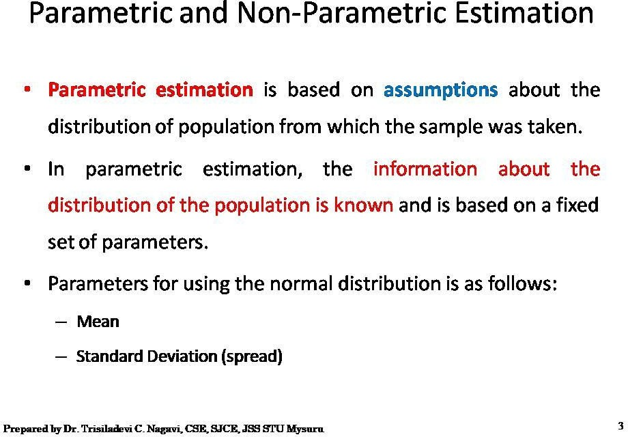

Slide 52
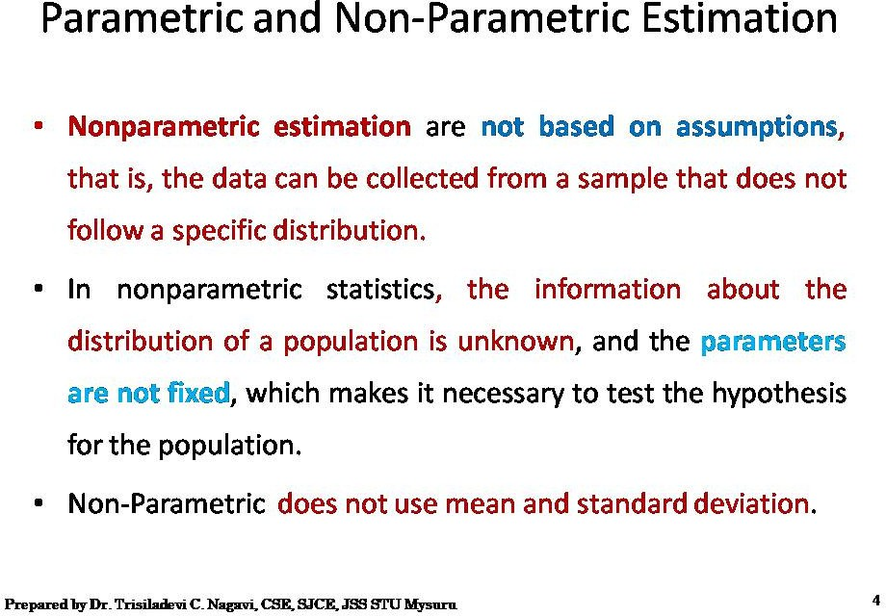

Slide 53
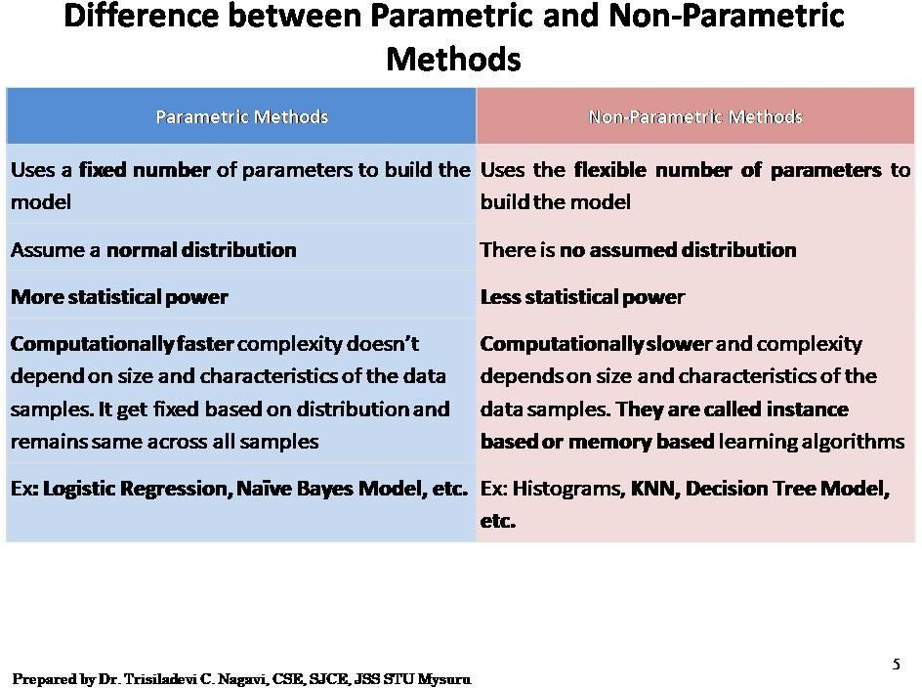

Slide 54


Slide 55



HISTOGRAM Continued
Histogram plots provide a fast and reliable way to visualize the probability density of a data sample.
A histogram is a plot that involves first grouping the observations into bins and counting the number of events that fall into each bin.
The counts, or frequencies of observations, in each bin are then plotted as a bar graph with the bins on the x-axis and the frequency on the y-axis.
One of the thumb rule to choose the number of intervals to be equal to the square root of the number of samples

Slide 56

Histogram Example

Slide 57
Histograms
Conceptually most simple and intuitive method to estimate a p.d.f. is a histogram.
Histograms are good for showing general distributional features of dataset variables.
The range of each dimension xi of vector X is divided into a fixed number m of intervals. The resulting M boxes (bins) of identical volume V count the number of points falling into each bin:
Assume we have N samples and the number of sample points in the j-th bin, bj , is K . Then the histogram estimate of the density is:
P(x) = (K/N)/V Here V is the size of the bin bj and x ϵ bj and x is any sample point
= K/(N*V)
Histograms hold the following properties: Not smooth
Depend on endpoints of bins Depend on width of bins

Slide 58


Slide 59


Slide 60


Slide 61


Slide 62


Slide 63


Slide 64


Slide 65


Slide 66

t
For Example : the height in the first row is 0.1/4 = 0.025

Slide 67



Slide 68


Slide 69


Slide 70

Continued …

Slide 71


Slide 72


Slide 73
Kernel and Window Estimators
Kernel density estimation is the process of estimating an unknown probability density function using a kernel function K(u)
While a histogram counts the number of data points in somewhat arbitrary regions, a kernel density estimate is a function defined as the sum of a kernel function on every data point.
Samples themselves can be thought of as very rough approximations to the true density function, namely a set of spikes or delta functions, one for each sample value with very small width and very large height such that the combined area of all spikes is equal to one.
This approximation to a continuous density estimation is not useful in decision making.
Each Delta function is replaced by Kernel Functions such as rectangles, triangles or normal density functions which have been scaled so that their combined area should be equal to one.

Slide 74


Slide 75


Slide 76


Slide 77


Slide 78


Slide 79


The first property of a kernel function is that it must be symmetrical. This means the values of kernel function is same for both +u and –u as shown in the plot below. This can be mathematically expressed as K (-u) = K (+u). The symmetric property of kernel function enables the maximum value of the function (max(K(u)) to lie in the middle of the curve.
The area under the curve of the function must be equal to one. Mathematically, this property is expressed as
The value of kernel function, which is the density, can not be negative, K(u) ≥ 0 for all −∞ < u < ∞.

Slide 80

Kernel Density Estimate
Method
Choose appropriate Kernels
Centre the Kernel on each of the data point
The density consists of a (normalized) sum of all overlapping kernel values at the given point
In Summary KDE
Use regions centered at the data points
Allow the regions to overlap
Let each individual contribute a total density of 1/N
With gaussian kernel, regions have soft edges to avoid discontinuity
Sample | 1 | 2 | 3 | 4 | 5 | 6
Value | -2.1 | -1.3 | -0.4 | 1.9 | 5.1 | 6.2

Slide 81

KERNEL DENSITY ESTIMATION

Slide 82

KERNEL DENSITY ESTIMATION

Slide 83


Slide 84


Slide 85


Slide 86
Problem Statement
1. Explain Kernel Density Estimation steps for a triangular kernel with base = 3 for sample points x1, x2, x3 = {1, 2, 4}
Given sample points: <x1, x2, x3> = <1, 2, 4>
Use a triangular kernel with base = 3
Perform Kernel Density Estimation (KDE)
Compute KDE at x = 2.5

Slide 87
Triangular Kernel Explanation
Triangular kernel formula:
K(u) = (1 - |u|) for |u| ≤ 1, else 0
Bandwidth h = base / 2 = 3 / 2 = 1.5
KDE formula:
f(x) = (1 / (n * h)) * Σ K((x - xi) / h)

Slide 88
KDE Computation at x = 2.5
Step 1: Compute u = (2.5 - xi) / 1.5 for xi in {1, 2, 4}
u1 = 1.5/1.5 = 1 → K(u1) = 0
u2 = 0.5/1.5 = 1/3 → K(u2) = 1 - 1/3 = 2/3
u3 = -1.5/1.5 = -1 → K(u3) = 0
Step 2: Apply KDE formula:
f(2.5) = (1 / (3 * 1.5)) * (0 + 2/3 + 0) = (1 / 4.5) * (2/3)
= 2 / 13.5 ≈ 0.148

Slide 89


Slide 90


Slide 91
Distance Metrics Continued
Dist (x,y) >= 0
Dist (x,y) = Dist (y,x) are Symmetric
Detours can not Shorten Distance Dist(x,y) <= Dist(x,z) + Dist (z,y)
z
X
y
X
z
y

Slide 92



Distance Metrics Continued
Manhattan Distance
|X1-X2| + |Y1-Y2|
•

Slide 93


Slide 94



Euclidean Distance
Distance Matrix

Slide 95



Minkowski Distance
Distance Matrix

Slide 96












Nearest Neighbors Classifiers
Basic idea:
– If it walks like a duck, quacks like a duck, then it’s probably a duck
Compute Distance
Test Record
Training Records
Choose k of the “nearest” records

Slide 97
K-Nearest Neighbors (KNN)
Simple, but a very powerful classification algorithm.
Classifies based on a similarity measure.
This algorithm does not build a model.
Does not “learn” until the test example is submitted for classification.
Whenever we have a new data to classify, we find its K-nearest neighbors from the training data.
Classified by “MAJORITY VOTES” for its neighbor classes.
Assigned to the most common class amongst its Knearest neighbors (by measuring “distance” between data)
In practice, k is usually chosen to be odd, so as to avoid ties.
The k = 1 rule is generally called the nearest-neighbor classification rule.

Slide 98
K-Nearest Neighbors (KNN)
K-Nearest Neighbor is one of the simplest Machine Learning algorithms based on Supervised Learning technique.
K-NN algorithm assumes the similarity between the new case/data and available cases and put the new case into the category that is most similar to the available categories.
K-NN algorithm can be used for Regression as well as for Classification but
mostly it is used for the Classification problems.
K-NN is a non-parametric algorithm, which means it does not make any assumption on underlying data.

Slide 99
K-NN algorithm stores all the available data and classifies a new data point based on the similarity. This means when new data appears then it can be easily classified into a well suite category by using K- NN algorithm.
It is also called a lazy learner algorithm because it does not learn from the training set immediately instead it stores the dataset and at the time of classification, it performs an action on the dataset.
KNN algorithm at the training phase just stores the dataset and when it gets new data, then it classifies that data into a category that is much similar to the new data.

Slide 100




Graphical analysis of K nearest Neighbour Technique
Given: a set P of n points in R^{d}
Goal: a data structure, which given a query point q, finds the
nearest neighbor p of q in P
p
q

Slide 101

Definition of Nearest Neighbor
K-nearest neighbors of a record x are data points that have the k smallest distance to x

Slide 102
1-Nearest Neighbor

Slide 103
3-Nearest Neighbor

Slide 104



Select 5 Nearest Neighbors
as Value of K=5 by Taking their Euclidean Disances

Slide 105

Nearest-Neighbor Classifiers
Requires three things
The set of stored records
Distance Metric to compute distance between records
The value of k, the number of nearest neighbors to retrieve
To classify an unknown record:
Compute distance to other training records
Identify k nearest neighbors
Use class labels of nearest neighbors to determine the class label of unknown record (e.g., by taking majority vote)

Slide 106
Nearest Neighbour (kNN) Classifier
How many neighbors should we count ?
(k=1)
(k=4)

Slide 107


Choosing k = 3, 5, 7 for classifying the new unknown sample

Slide 108

Value of K
Choosing the value of k:
If k is too small, sensitive to noise points
If k is too large, neighborhood may include points from other classes
Rule of thumb:
K = sqrt(N)
N: number of training points

Slide 109
Choosing K Value
There is no structured method to find the best value for “K”. We need to find out with various values by trial and error and assuming that training data is unknown.
Choosing smaller values for K can be noisy and will have a higher influence on the result.
Larger values of K will have smoother decision boundaries which mean lower variance but increased bias. Also, computationally expensive.
In general, practice, choosing the value of k is k = sqrt(N) where N stands for the number of samples in your training dataset.
Try and keep the value of k odd in order to avoid confusion between two classes of data

Slide 110
Algorithm
Step-1: Select the value for K neighbors
Step-2: Calculate the Euclidean distance from the test sample to every sample point in the dataset.
Step-3: Take the K nearest neighbors as per the calculated Euclidean distance.
Step-4: Among these k neighbors, count the number of the data points in each category.
Step-5: Assign the new data points to that category for which the number of the neighbor is maximum.
Step-6: Our model is ready.

Slide 111


Slide 112
Consider the following data set of a pharmaceutical company with assigned class labels, using K nearest neighbour method classify a new unknown sample using k =3 and k = 2.
Points | X1 (Acid Durability ) | X2(strength) | Y=Classification
P1 | 7 | 7 | BAD
P2 | 7 | 4 | BAD
P3 | 3 | 4 | GOOD
P4 | 1 | 4 | GOOD

Slide 113

Points | X1(Acid Durability) | X2(Strength) | Y(Classification)
P1 | 7 | 7 | BAD
P2 | 7 | 4 | BAD
P3 | 3 | 4 | GOOD
P4 | 1 | 4 | GOOD
P5 | 3 | 7 | ?

Slide 114
KNN P2
P1
P3
P4
Euclidean Distance of P5(3,7)
from
(7,7)
(7,4)
(3,4)
(1,4)

Slide 115

Euclide an Distanc e of P5(3,7) from | P1 | P2 | P3 | P4
 | (7,7) | (7,4) | (3,4) | (1,4)
Class | BAD | BAD | GOOD | GOOD

Slide 116
New customer named 'Mary’ has height 161cm and weight 61kg. Suggest the T shirt Size with K=3,5 using Euclidean Distance and Also Manhattan Distance
Height (in cms) | Weight (in kgs) | T Shirt Size
158 | 58 | M
158 | 59 | M
158 | 63 | M
160 | 59 | M
160 | 60 | M
163 | 60 | M
163 | 61 | M
160 | 64 | L
163 | 64 | L
165 | 61 | L
165 | 62 | L
165 | 65 | L
168 | 62 | L
168 | 63 | L
168 | 66 | L
170 | 63 | L
170 | 64 | L
170 | 68 | L

Slide 117


There is a Car manufacturer company that has manufactured a new SUV car. The company wants to give the ads to the users who are interested in buying that SUV. So for this problem, we have a dataset that contains multiple user's information through the social network. The dataset contains lots of information but the Estimated Salary and Age we will consider for the independent variable and the Purchased variable is for the dependent variable. Dataset is as shown in the table. Using K =5 classify the new sample

Slide 118


Slide 119


Slide 120
Advantages of KNN Algorithm:
It is simple to implement.
It is robust to the noisy training data
It can be more effective if the training data is large.
Disadvantages of KNN Algorithm:
Always needs to determine the value of K which may be complex some time.
The computation cost is high because of calculating the distance between the test data point and all the samples present in the dataset.

Slide 121
Applications of KNN
Banking System : KNN can be used in banking system to predict whether an individual is fit for loan approval? Does that individual have the characteristics similar to the defaulters one?
Credit Ratings : KNN algorithms can be used to find an individual’s credit rating by comparing with the persons having similar traits.
Politics : With the help of KNN algorithms, we can classify a potential voter into various classes like “Will Vote”, “Will not Vote”, “Will Vote to Party ‘Congress’, “Will Vote to Party ‘BJP’.
KNN algorithm can be used are Speech Recognition, Handwriting Detection, Image
Recognition and Video Recognition.

Slide 122
Problem Statement
Compute the density for the data samples
<3, 4.5, 5.2, 6, 7.5, 8.2>
using a bin width 2 and sketch the density plot.

Slide 123
Step 1: Identify Data Range and Define Bins
Data samples: {3, 4.5, 5.2, 6, 7.5, 8.2}
Minimum = 3, Maximum = 8.2
Defined bins (width = 2):
• [2, 4)
• [4, 6)
• [6, 8)
• [8, 10)

Slide 124
Step 2: Count Samples in Each Bin
• Bin [2, 4): {3} → count = 1
• Bin [4, 6): {4.5, 5.2} → count = 2
• Bin [6, 8): {6, 7.5} → count = 2
• Bin [8, 10): {8.2} → count = 1

Slide 125
Step 3: Compute Density
Formula: Density = Count / (n × Bin width), where n = 6
• [2, 4): 1 / (6×2) = 1/12 ≈ 0.083
• [4, 6): 2 / (6×2) = 2/12 ≈ 0.167
• [6, 8): 2 / (6×2) = 2/12 ≈ 0.167
• [8, 10): 1 / (6×2) = 1/12 ≈ 0.083

Slide 126
Bin Range | Count | Density
[2, 4) | 1 | 0.083
[4, 6) | 2 | 0.167
[6, 8) | 2 | 0.167
[8, 10) | 1 | 0.083

Slide 127
End of Unit 2

